Slide 1

Bangladesh University of Business & Technology(BUBT)
Project on,
MediBox: an IoT based smart medicine dispenser for optimal healthcare with mobile app assistance and security system.

Slide 2
Presented by, Md Sakib Mia(19202103401) Tanvir Ahmed(19202103402) Afsana Azad Sarna(19202103414) Kawser Ahamed(19202103428) Rafiqul Islam(19202103276)
Presented To,
Khan Md. Hasib,
Assistant Professor,
Dept. of CSE, BUBT
Project supervised by,
Sadah Anjum Shanto,
Assistant Professor,
Department of Computer Science and Engineering (CSE),BUBT

Slide 3
Table Of Contents
Intoduction
Objective
Methodology
Literature Review
Critical Challenges
Conclusion

Slide 4
01
02
03
04
Introduction
The patient can receive notifications and reminders.
MediBox is an automatic system that can dispense pills to the right patient at the right time automatically.
The device alerts the patient before the designated time for taking the pills.
05
Implementing robust encryption and decryption algorithms for data security.
Here you could describe the topic of the section

Slide 5
Objectives
Automatically dispense pills to patients on time.
Reduce the risk of incorrect medication or missed doses.
Remind patients about the correct medication using personalized alarms and reminders.
Ensure that caretakers can monitor multiple patients whether patients have taken their pills or not.
Provide a user-friendly mobile application interface for controlling and monitoring all aspects of the system.

Slide 6
Methodology
Software and hardware.
Flowgraph of our system.

Slide 7
Software and Hardware
Software
VS Code
Firebase
Arduino
Android Emulator
Hardware
NodeMCU
ServoMotor
LED/Buzzer
IR Sensor

Slide 8
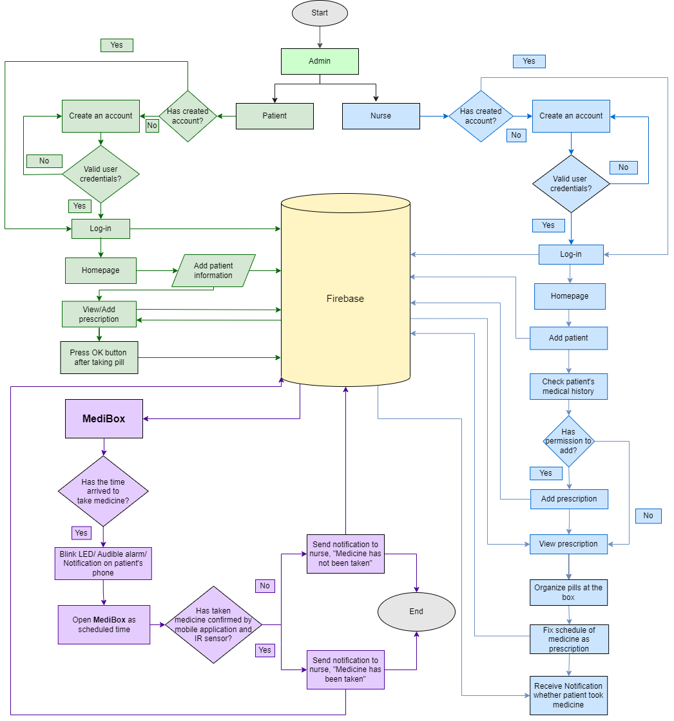
Flowgraph

Slide 9
Literature Review
Existing Pill Dispenser Technologies
Automatic Pill Dispenser Systems
Manual pill dispensers
No smart features
Limited automation
Electronic lacks integration.
Advanced pill dispensers enhance adherence.
Satisfaction with alarms and compartments.
Hardware Design and User Interface
IoT and Smart Healthcare
Hardware design: size, capacity, safety
User-friendly interface for patient interaction.
IoT in healthcare: smart devices aid medication management
Offer benefits.

Slide 10
Conclusion
MediBox represents a promising solution to enhance medication management, promoting adherence and patient safety.
With seamless connectivity and robust security measures, this technology has the potential to revolutionize medication administration for improved health outcomes.

Slide 11
Thank You

